Slide 1
HACK-A-CLOUD 2.0
TEAM NAME: Cloud Wanderers
PROJECT TITLE: Deploying an application on AWS using Amplify
TEAM MEMBERS:
1. Chris Glary C IT SJCE
2. Arockia Shermila S ADS SJIT
ECS EXPLORERS

Slide 2
Deploying a bucket list application tracker on aws amplify
The project's goal is to build and launch a bucket list tracker application on AWS Amplify, which will let users to maintain and track their bucket lists. The application employs AWS Amplify services for authentication, data storage, and real-time updates, resulting in a secure and scalable user experience. Continuous deployment ensures that the application is constantly updated with the most recent features.

Slide 3
PROBLEM STATEMENT
-
The project involves deploying a React web application on AWS infrastructure using Amplify, aiming for a streamlined , scalable, and secure deployment process. The solution should enable continuous integration, automate build processes, and manage backend services, while adhering to best practices for performance, reliability, and cost optimization.

Slide 4
ABSTRACT
Deploying React Web Application on AWS
• Utilizes Amplify for full-stack serverless applications. • Integration with AWS services for seamless build processes. • Enables continuous integration and delivery (CI/CD). • Provides easy management of backend services. • Aims for scalable, secure, cost-effective deployment. • Utilizes AWS resources efficiently. • Enhances user experience and development efforts.

Slide 5
PROPOSED SYSTEM
The bucket list tracker application may be deployed on AWS Amplify in a few steps:
First, the frontend framework is used to create the user interface, which includes functions such as user login and item management.
The backend is set up with AWS Amplify, which handles authentication, data storage, and API.
The application is then coupled with AWS Amplify, which provides built-in authentication, data fetching, and mutation capabilities.
The application is tested and debugged locally before being deployed to the Amazon Web Services cloud.
Continuous Integration and Deployment (CI/CD) pipelines are configured to automate the build, testing, and deployment procedures.
Regular maintenance actions are carried out to improve performance and scale resources.

Slide 6
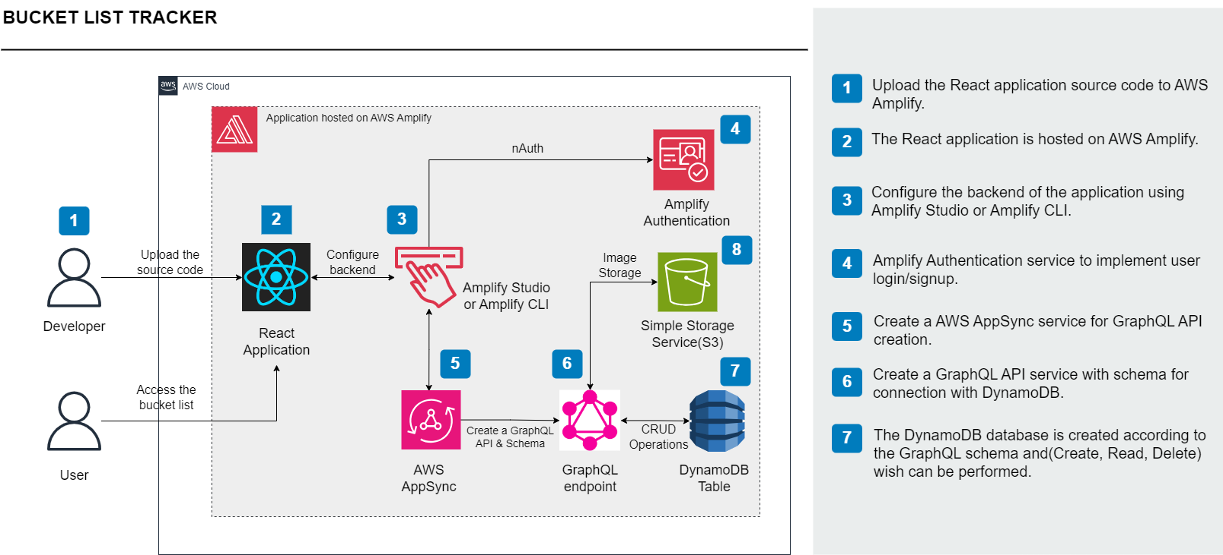
ARCHITECTURE
TECH STACK
React: Development of web application
AWS Amplify: Deployment of frontend and backend services.
AWS AppSync: Simplifies building and managing scalable GraphQL APIs.
GraphQL API: Allows clients to request only the data they need. [API & Schema]
DynamoDB: DynamoDB for storing and managing bucket list items.[Database]
S3 bucket: For storage of user images. [Storage]
Enter your diagram here

Slide 7
USE CASE
AWS Amplify Bucket List Tracker Application Usage:
Personal Goal Tracking: Individuals can manage their personal bucket lists.
Collaborative Goal Setting: Shared bucket lists allow multiple users to contribute, edit, and track goals.
Educational Objectives: Students and educators can set educational goals and manage study plans.
Professional Development: Professionals can track career goals, skill development objectives, certifications, and training milestones.
Bucket List Communities: Communities can create and share bucket lists related to specific themes, hobbies, or experiences.

Slide 8
CONCLUSION
A bucket list tracker application on AWS Amplify provides scalability, security, and easy integration to help customers monitor their goals. Developers can iterate on the application by running continuous deployment pipelines from GitHub to AWS S3. The application supports a variety of use cases and has the possibility for future improvements such as mobile app compatibility, offline support, social sharing, gamification, analytics, accessibility, localization, and user feedback methods.

